Slide 1
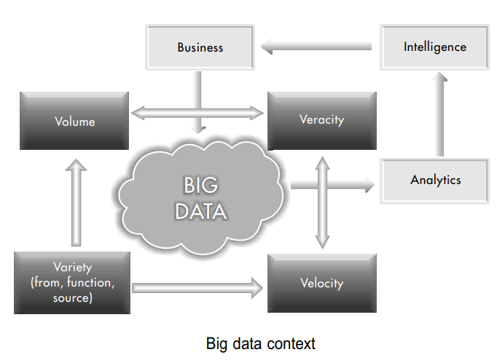
Big Data is an all-inclusive term that refers to extremely large, very fast, highly diverse, and complex data that cannot be managed with traditional data management tools.
Ideally, Big Data includes all kinds of data, which helps deliver the right information, to the right person, in the right quantity, at the right time, to help make the right decisions. Big Data can be harnessed (bound) by developing infinitely scalable, flexible, and evolutionary data architectures, coupled with the use of cost-effective computing machines.

Slide 2
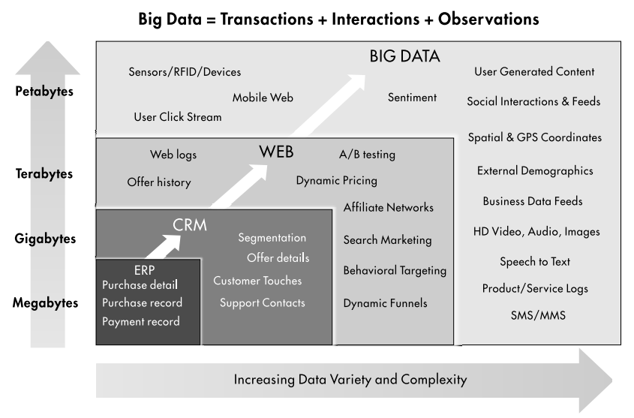

Slide 3
If data were only growing too large, or only moving too fast, or only becoming too diverse, it would have been relatively easy. However, when three Vs (Volume, Velocity, Variety) arrive together in an interactive manner, it creates a perfect storm
Volume of the Data
The quantity of data generated in the world has been relentlessly doubling every 12–18 months.
Traditional data is measured in Gigabytes (GB) and Terabytes (TB), but Big Data is measured in Petabytes (PB) and Exabytes (1 Exabyte = 1 Million TB).
This data is so huge that it is almost a miracle that one can find any specific thing in it, in a reasonable period of time.
Reason:
→ Dramatic reduction in the cost of storing data. The costs of storing data have decreased by 30–40 per cent every year. Therefore, there is an incentive to record everything that can be observed. It is called ‘datafication’ of the world.

Slide 4
Velocity of Data
If traditional data is like a lake, Big Data is like a fast-flowing river. Big Data is being generated by billions of devices, and communicated at the speed of the light, through the internet. Ingesting (feeding) all this data is like drinking from a fire hose.
One does not have any control over how fast the data will come. A huge unpredictable data-stream is the new metaphor (symbol) for thinking about Big Data.
Reasons:
The primary reason for the increased velocity of data is the increase in internet speed.
For example, Internet speeds available to homes and offices are now
increasing from 10 MB/s to 1 GB/s (100 times faster).

Slide 5
Variety of Data
Big Data is inclusive of all forms of data, for all kinds of functions, from all sources and devices. For example, Big Data is the biggest imaginable shopping mall that offers unlimited variety. There are three major kinds of variety of data:
The first aspect of variety is the Form of data→ Data types range in variety from numbers to text, graph, map, audio, video, and others, with some being simple and others being very complex.
The second aspect of variety is the Function of data→ There is data from human conversations, songs and movies, business transaction records, machine operations performance data, new product design data, old archived data, etc.
The third aspect of variety is the Source of data→ Mobile phone and tablet devices enable a wide series of applications (or apps). Web access and search logs are another new and huge source of data.

Slide 6
Collection of three V’s, there is another term “V” has been generated.
“V” for Veracity of Data
Veracity of Data relates to the truthfulness, believability, and quality of data. Big Data is messy and there is considerable misinformation and disinformation out there.
Impact:
The reasons for poor quality of data can range from technical error, to human error, to malicious intent.

Slide 7
Why Veracity of Data?
The source of information may not be authoritative. For example, all websites are not equally trustworthy. Any information from whitehouse.gov or from nytimes. com is more likely to be authentic and complete. What about “Wikipedia”?
The data may not be communicated and received correctly because of human or technical failure. Sensors and machines for gathering and communicating data may malfunction and may record and transmit incorrect data.
The data provided and received may, however, also be intentionally wrong for competitive or security reasons. There could be disinformation and malicious information spread for strategic reasons.

Slide 8
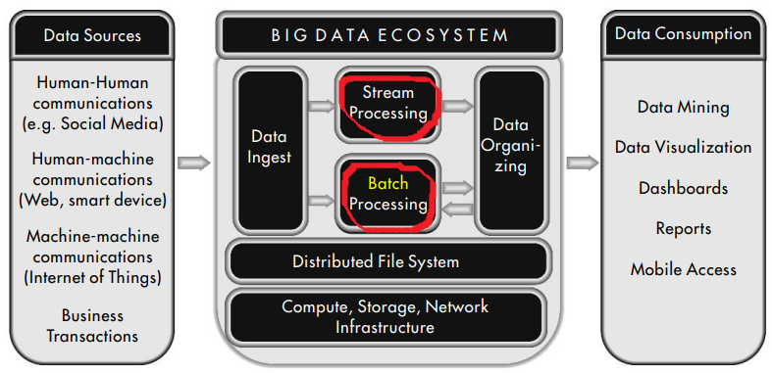
ORGANIZING BIG DATA
ANALYZING BIG DATA
First way is to process the incoming stream of data in real time for quick and effective statistics about the data.
The second way is to store and structure batches of data and apply standard analytical techniques on for generating insights.
Big data architecture

Slide 9
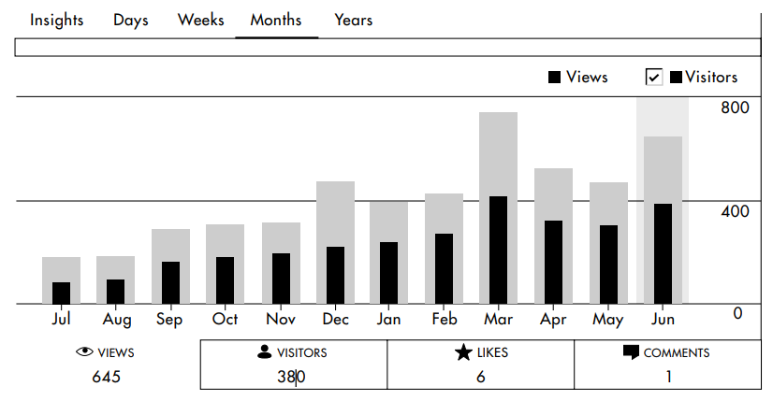
Real-time dashboard for website performance for the author’s blog

Slide 10
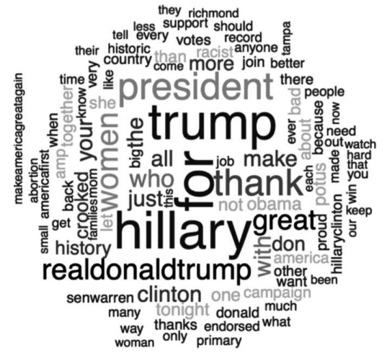
A wordcloud of Hillary Clinton’s and Donald Trump’s tweets (2016)

Slide 11
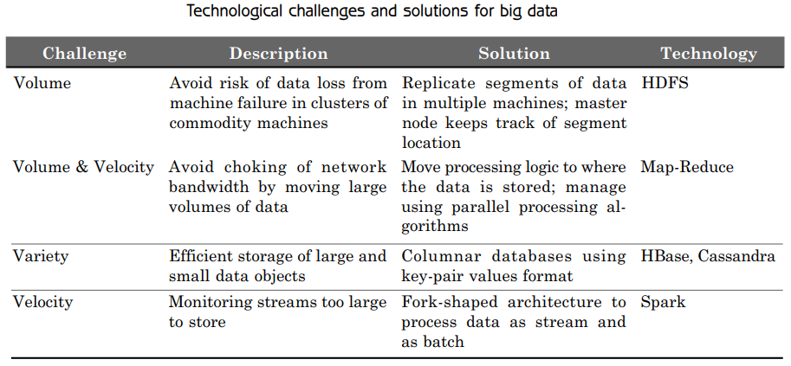
TECHNOLOGY CHALLENGES FOR BIG DATA
Storing Huge Volumes
Ingesting Streams at an Extremely Fast Pace
Handling a Variety of Forms and Functions of Data
Processing Data at Huge Speeds
Hadoop Distributed File System

Slide 12
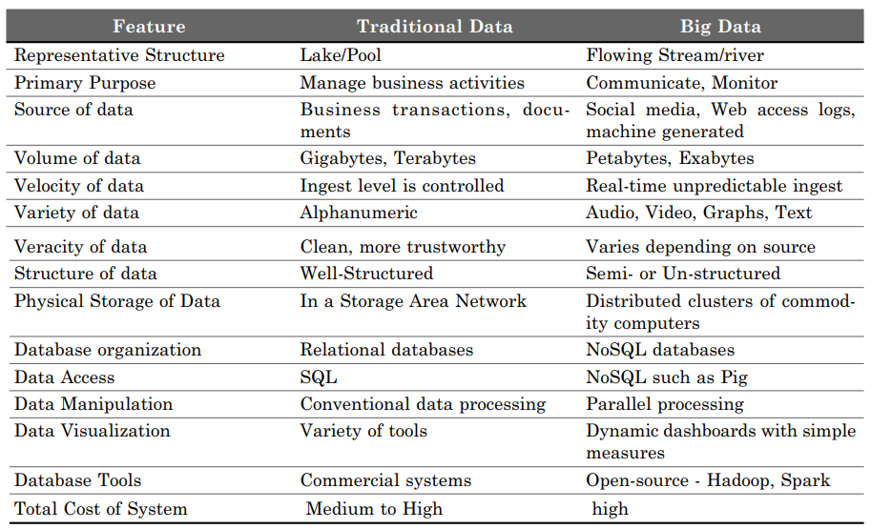
Comparing big data with traditional data

Slide 13
Case study page no. 22
Fig. 2.2

Slide 14
BIG DATA SOURCES
i. People-to-People Communications
example. Social Media
ii. People-to-Machine Communications
example. Smart watch, IoT based medical equipment, web-address
iii. Machine-to-Machine Communications
example. RFID tag, sensors

Slide 15
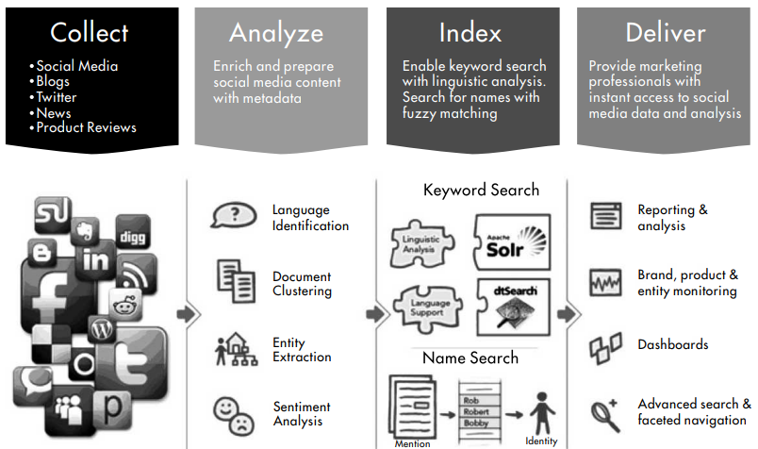
BIG DATA APPLICATIONS
Monitoring and Tracking Applications (vehicle tracking system)
Public Health Monitoring
Consumer Sentiment Monitoring (Social media based business)
Asset Tracking (airplane black box recording)
Supply Chain Monitoring
Electricity Consumption Tracking
Preventive Machine Maintenance, etc

Slide 16
Analysis and Insight Applications
Predictive Policing
exmpl. The Los Angeles Police Department (LAPD) invented the concept of
Predictive Policing
Winning Political Elections
exmpl. The US President, Barack Obama, was the first major political candidate to use Big Data in a significant way, in the 2008 elections. He is the first Big Data president. His campaign gathered data about millions of people, including supporters. They invented the mechanism to obtain small campaign contributions from millions of supporters.
Personal Health
New Product Development
Flexible Auto Insurance
Location-based Retail Promotion
Recommendation Service

Slide 17
Case Study
Page 34
Google Query Architecture

Slide 18
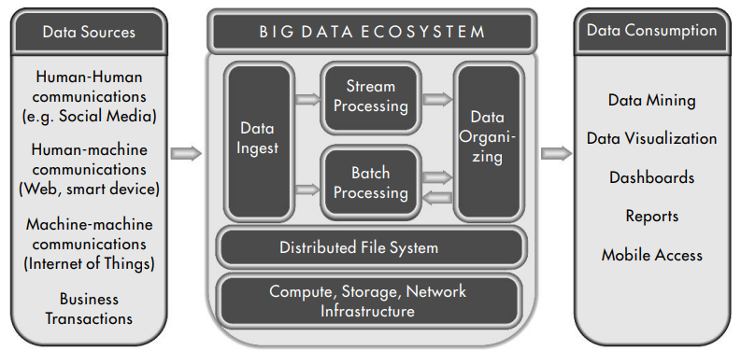
Data Ingest layer
This layer is responsible for acquiring data from the various data sources.
Incoming data is received through a scalable number of input points, that can acquire data at various speeds and in various quantities.
Batch Processing layer
This layer receives data from the ingest point or from the file system or from the NoSQL databases.
Data is processed using parallel programming techniques (such as MapReduce) to process it and produce the desired results.
Stream Processing
This layer receives data directly from the ingest point.
Data is processed using parallel programming techniques (such as MapReduce) to process it in real time, and produce the desired results.
Data Organizing Layer This layer receives data from both the batch and stream processing layers. Its objective is to organize the data for easy access.
Distributed File System Layer This is the heart of a Big Data system. It would store huge quantities of data and make it quickly and securely available and accessible to the other layers. Hadoop Distributed File System (HDFS) is the primary technology in this layer.

